Slide 1
Testbed information
Some testbed parameters:
Default TTL of RDMA packets: 16;
Switch forwarding-mode: store-and-forward;
Link capacity: 40Gbps;
Switch buffer size: 12MB;
Configured maximum frame size: 1024 bytes;
Information we can read from switches:
instantaneous queue length of each egress port;
instantaneous traffic rate of each ingress and egress port;
Total number of pauses received per egress port.

Slide 2
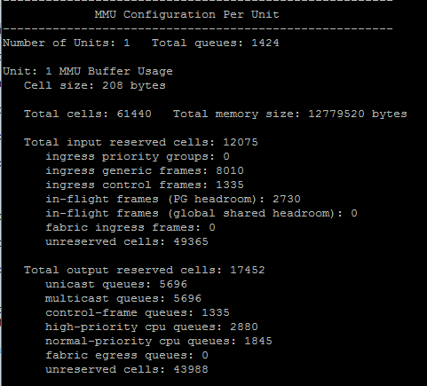
Switch buffer information

Slide 3
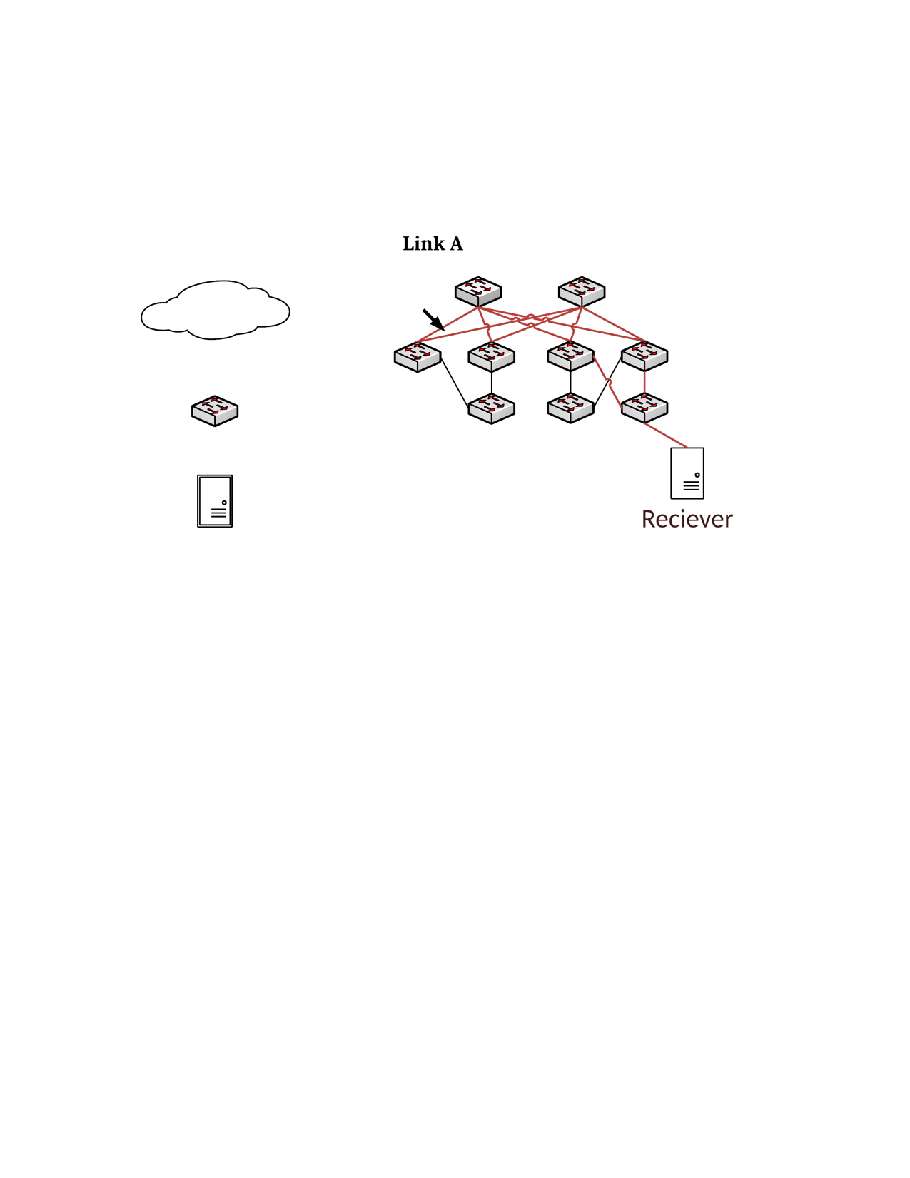
PFC deadlock experiment-1
S1
S2
L1
L3
L4
172.16.4.0/31 -> T4
1
2
40Gbps
30
30
172.16.4.5/32 -> L4
T1
T3
T4
H1: 172.16.3.6
H2: 172.16.4.5

Slide 4

PFC deadlock experiment-1
L4-1-rx
L4
L4-2-tx
L4-2-rx
Queue | Queue length
T3-30-tx | 2076256 bytes (~2MB)
L4-2-tx | 3495232 bytes (~3.5MB)
T4-30-tx | 2092480 bytes (~2MB)
3.5MB
$$\text{β}$$
2MB
T3
T4
2MB
T3-30-tx
T4-30-rx
T4-30-tx

Slide 5
Analysis about PFC deadlock
Time unit 0:
L4-1-rx
L4
queueing delay of the 1st pkt
Round | Time unit | Queueing delay | Remaining TTL
#1 | 0 | 0 | 15
L4-2-tx
L4-2-rx
$$\text{β}$$
T3
T4
T3-30-tx
T4-30-rx
T4-30-tx
*Let the time to send one 1KB pkt at rate 40Gbps to next hop as one time unit (~0.2us).

Slide 6
Analysis about PFC deadlock
Time unit 1:
L4-1-rx
L4
queueing delay of the 1st pkt
Round | Time unit | Queueing delay | Remaining TTL
#1 | 0 | 0 | 15
L4-2-tx
L4-2-rx
$$\text{β}$$
T3
T4
T3-30-tx
T4-30-rx
T4-30-tx
*Let the time to send one 1KB pkt at rate 40Gbps to next hop as one time unit (~0.2us).

Slide 7
Analysis about PFC deadlock
Time unit 2:
L4-1-rx
L4
queueing delay of the 1st pkt
Round | Time unit | Queueing delay | Remaining TTL
#1 | 0 | 0 | 15
#2 | 2 | 1 | 13
L4-2-tx
L4-2-rx
$$\text{β}$$
T3
T4
T3-30-tx
T4-30-rx
T4-30-tx
*Let the time to send one 1KB pkt at rate 40Gbps to next hop as one time unit (~0.2us).

Slide 8
Analysis about PFC deadlock
Time unit 191:
L4-1-rx
L4
queueing delay of the 1st pkt
Round | Time unit | Queueing delay | Remaining TTL
#1 | 0 | 0 | 15
#2 | 2 | 1 | 13
#3 | 5 | 4 | 11
#4 | 11 | 10 | 9
#5 | 23 | 22 | 7
#6 | 47 | 46 | 5
#7 | 95 | 94 | 3
#8 | 191 | 190 | 1
L4-2-tx
L4-2-rx
$$\text{β}$$
T3
T4
T3-30-tx
T4-30-rx
T4-30-tx
*Let the time to send one 1KB pkt at rate 40Gbps to next hop as one time unit (~0.2us).

Slide 9
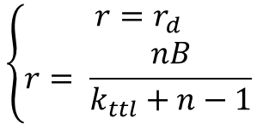
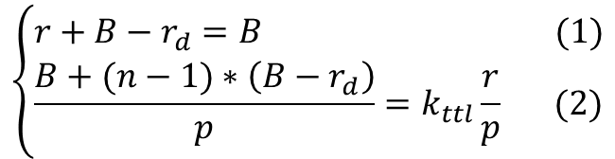
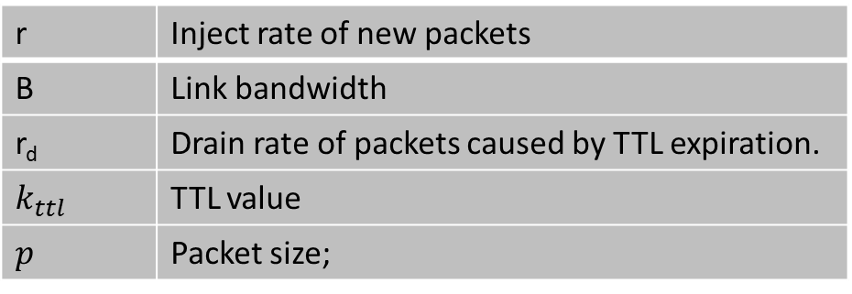
Analysis of the steady-state
r | Inject rate of new packets
B | Link bandwidth
r_{d} | Drain rate of packets caused by TTL expiration.
$$k_{ttl}$$ | TTL value
$$p$$ | Packet size;
r
B - r_{d}
L4-2-tx
$$\left\{\begin{aligned}r+B−r_{d}=B (1) \\ \frac{B+(n−1)∗\left(B−r_{d}\right)}{p}=k_{ttl}\frac{r}{p} (2)\end{aligned}\right.$$
input rate = output rate
TTL conservation.
B
$$\left\{\begin{aligned}r{=r}_{d} \\ r= \frac{nB}{k_{ttl}+n−1}\end{aligned}\right.$$
With the parameters in the experiment, we have r = 5Gbps.

Slide 10
PFC deadlock experiment-2
Experiment results under different settings: memory size are all set to 4MB.
Msg size per post(KB) | 4 | 8 | 10 | 50 | 100 | 110 | 150 | 200 | 400
Sending rate(Gbps) | 10 | 25 | 30 | 40 | 40 | 40 | 40 | 40 | 40
PFC deadlock | No | No | No | No | No | Yes | Yes | Yes | Yes

